Slide 1
For Live Session
Unit 6
Chad Madding

Slide 2
FACE
Framing the problem
Making OT Assignment Decisions Today for Tomorrow’s Flight Schedule
Analysis/solving the problem
1. Pull data from database (SQL)
2. Select desired fields and set data names/types
3. Full Outer Join two data sets
4. Sort Data
5. View Data

Slide 3
FACE
Communicating and
acting on results
Embedding final models
and methods in enterprise
business processes
and systems

Slide 4
Activity 3
Which do you think OAG will be able to help more with; Diana’s OTP problem or Alec’s Open Time Problem?
Alec’s problem dealt with employees not being able to work a shift or flight. OAG does not track real time data on employees being sick. There maybe some scheduling data that might help in Alec’s case but for the most part this type of service will help with Diana’s OTP problem.

Slide 5
Activity 3
OAG is a third party data and solutions provider for the airline industry. Does your industry have third party companies that offer similar data and solutions?
In the area I work at this time we do not use any third party data providers. We have the recourses to process and evaluate our own data.

Slide 6
Activity 4: Data Science and Careers
Check out the careers at OAG
Just reading the titles, are any of them listings for a “Data Scientist”?
There are no positions listed in the area of Data Scientist.
Now read the Job Descriptions. Which jobs do not require “analysis” or “statistics”.
All three job listed on the site required analytics. None of the three listed statistics.
What does this suggest to you (if it suggests anything) about the role of data science in the modern work force?
Moving forward it looks like companies, at least this one, are looking more for analyst and less for statisticians.
Given what you know about OAG so far (which granted may not be in depth) where would you place them on the 5 Levels / Stages of Analytical Competition.
OAG would be in Stage 5. They are not only using analytics to compete in the marketplace they are selling the service so that others can too.

Slide 7
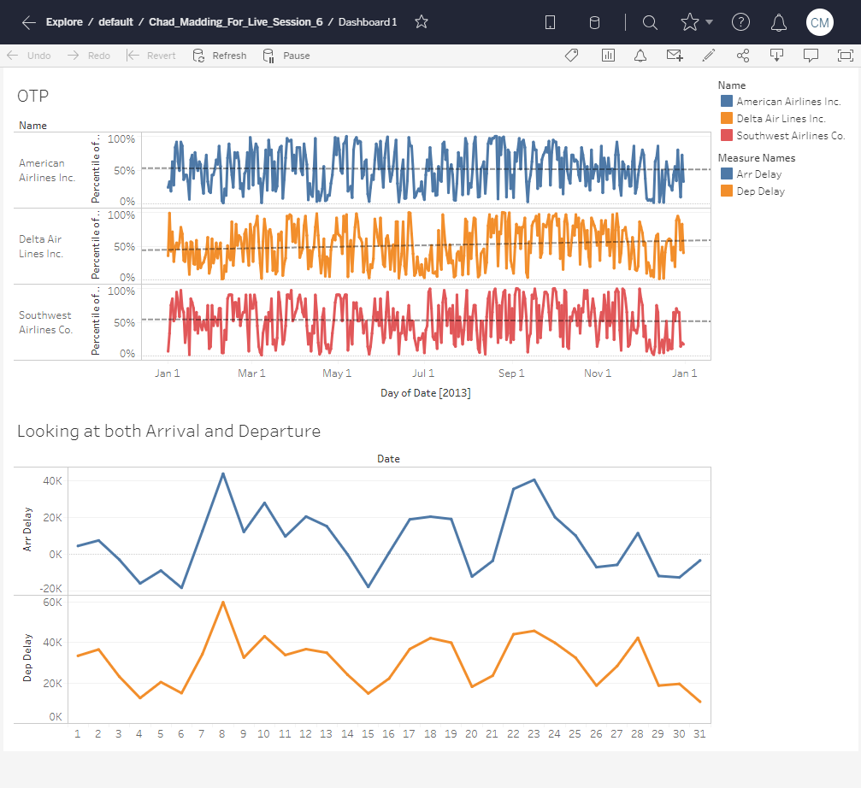
Activity 5: Deploying with Tableau
https://prod-useast-a.online.tableau.com/#/site/smudatascience/views/Chad_Madding_For_Live_Session_6/Dashboard1?:iid=1

